Slide 1

Fake News Detection Project
Submitted by-
Sankalp Mahapatra
Internship 29

Slide 2
TABLE OF CONTENTS
INTRODUCTION
Business Problem Framing
CONCEPTUAL BACKGROUND OF THE DOMAIN PROBLEM
Motivation for the Problem undertaken
Exploratory Data Analysis (EDA)
Data Visualization
Model/s Development and Evaluation
Hyperparameter tuning using GridSearchCV
Conclusion

Slide 3
INTRODUCTION
Context Fake news has become one of the biggest problems of our age. It has serious impact on our online as well as offline discourse. One can even go as far as saying that, to date, fake news poses a clear and present danger to western democracy and stability of the society.Content What's inside is more than just rows and columns. Make it easy for others to get started by describing how you acquired the data and what time period it represents, too. What is a Fake News? Fake news's simple meaning is to incorporate information that leads people to the wrong path. Nowadays fake news spreading like water and people share this information without verifying it. This is often done to further or impose certain ideas and is often achieved with political agendas. For media outlets, the ability to attract viewers to their websites is necessary to generate online advertising revenue. So it is necessary to detect fake news.

Slide 4
Workflow
In this project, we are using some machine learning and Natural language processing libraries like NLTK, re (Regular Expression), Scikit Learn.
Natural Language Processing Machine learning data only works with numerical features so we have to convert text data into numerical columns. So we have to preprocess the text and that is called natural language processing. In-text preprocess we are cleaning our text by steaming, lemmatization, remove

Slide 5
stopwords, remove special symbols and numbers, etc. After cleaning the data we have to feed this text data into a vectorizer which will convert this text data into numerical features.
-Dataset You can find many datasets for fake news detection on Kaggle or many other sites. I download these datasets from Kaggle. There are two datasets one for fake news and one for true news. In true news, there is 21417 news, and in fake news, there is 23481 news. You have to insert one label column zero for fake news and one for true news. We are combined both datasets using pandas built-in function.

Slide 6
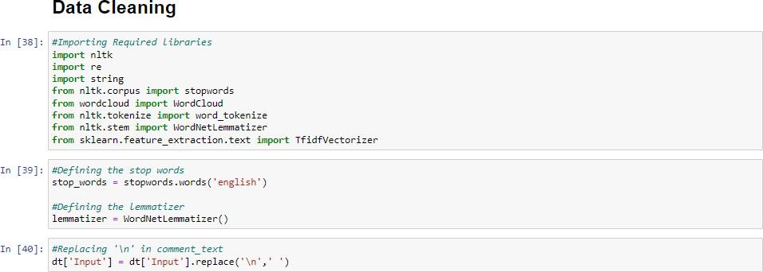
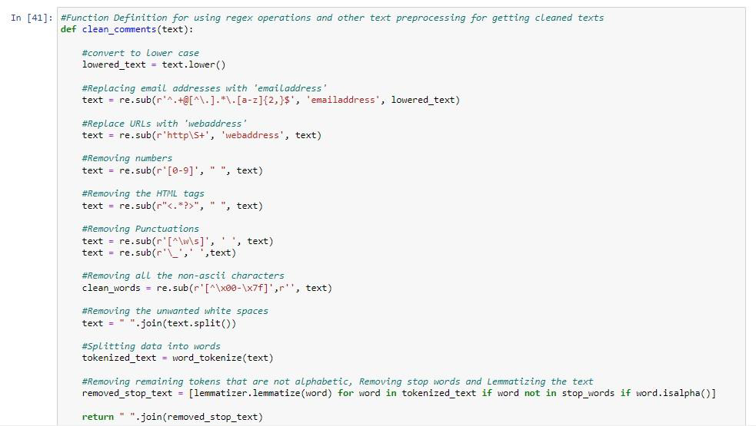
Data Preprocessing

Slide 7
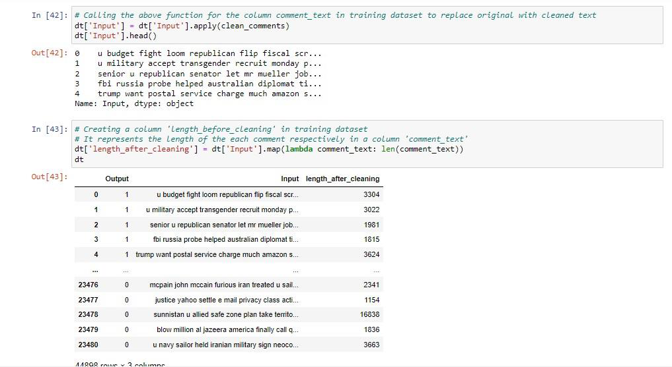

Slide 8
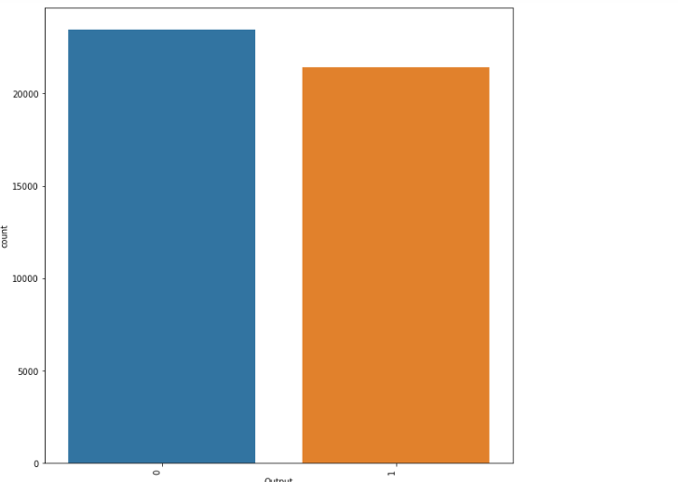
Visualizations

Slide 9
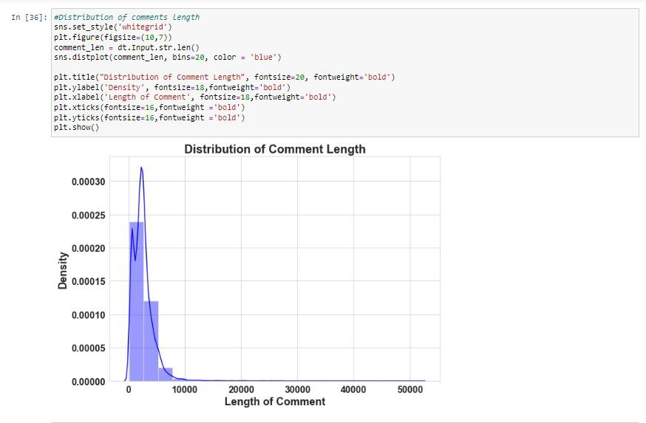

Slide 10
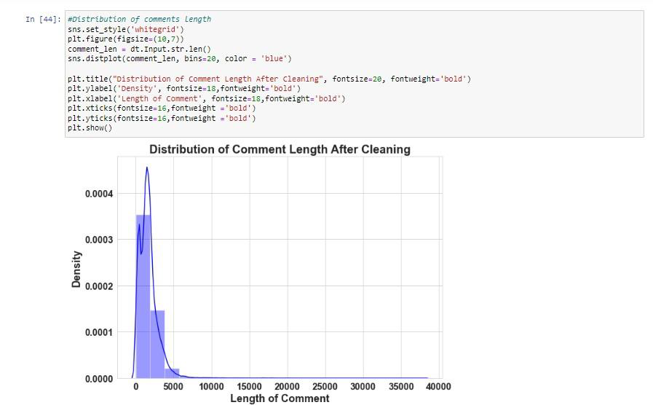

Slide 11
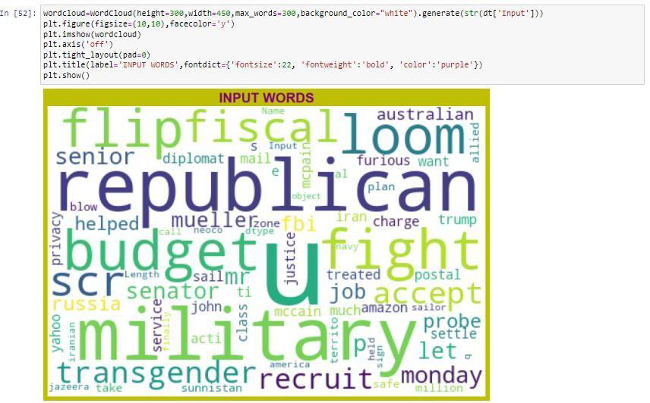

Slide 12
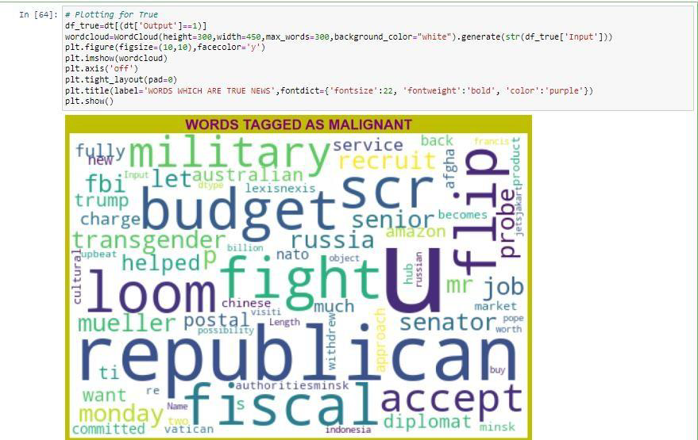

Slide 13
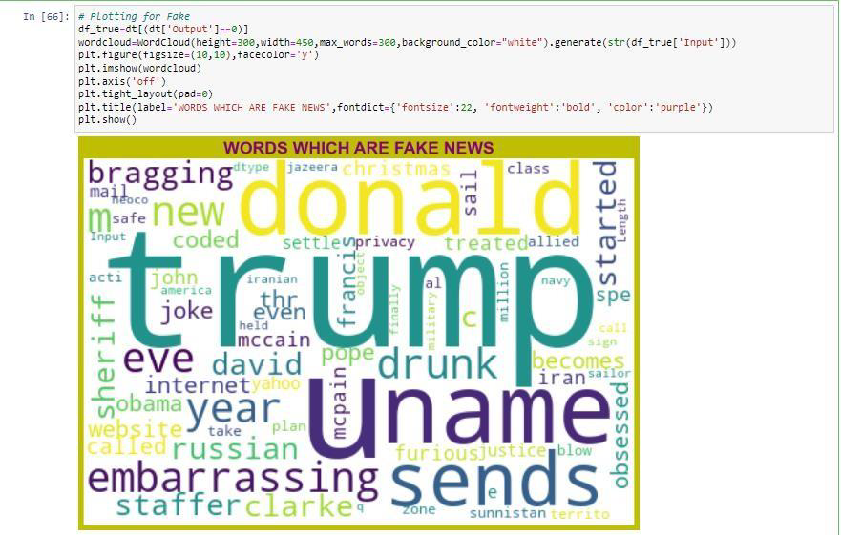

Slide 14
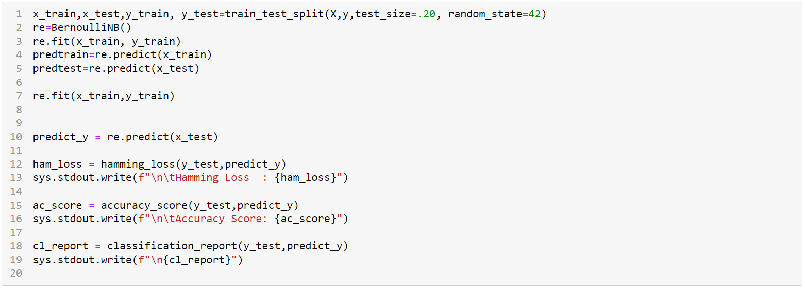
Model/s Development and Evaluation

Slide 15
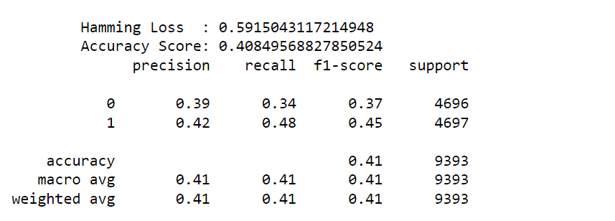

Slide 16
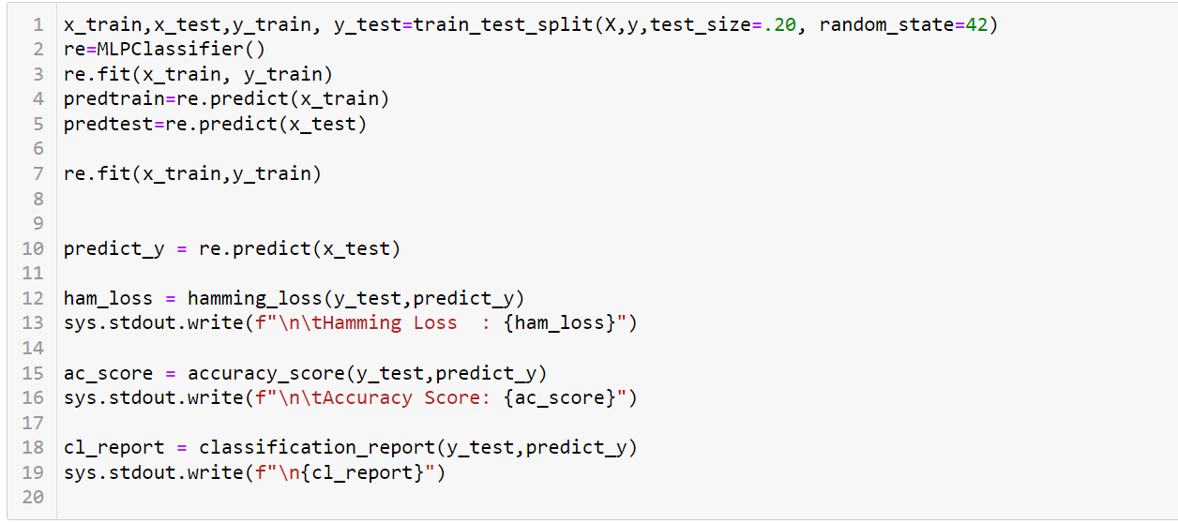

Slide 17
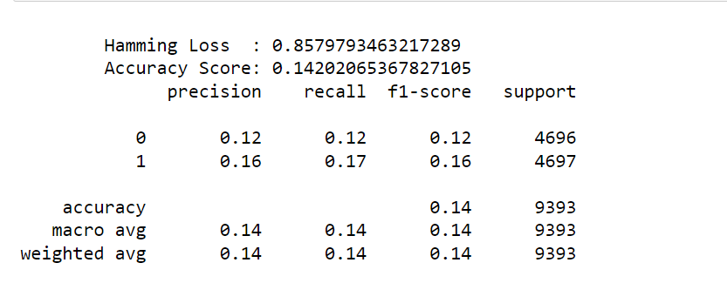

Slide 18
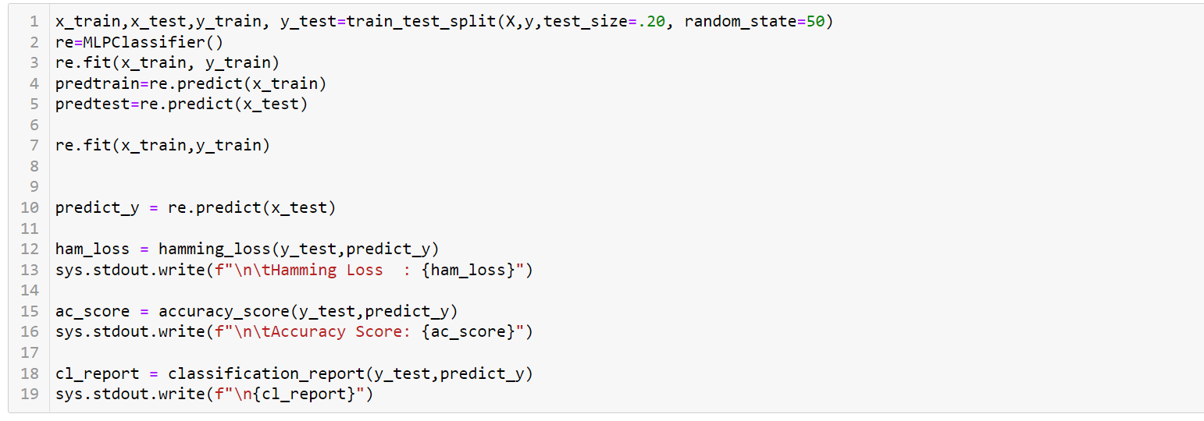

Slide 19
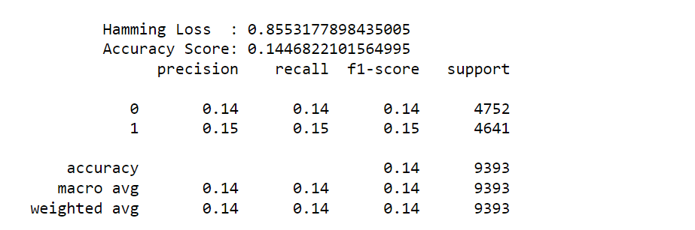

Slide 20
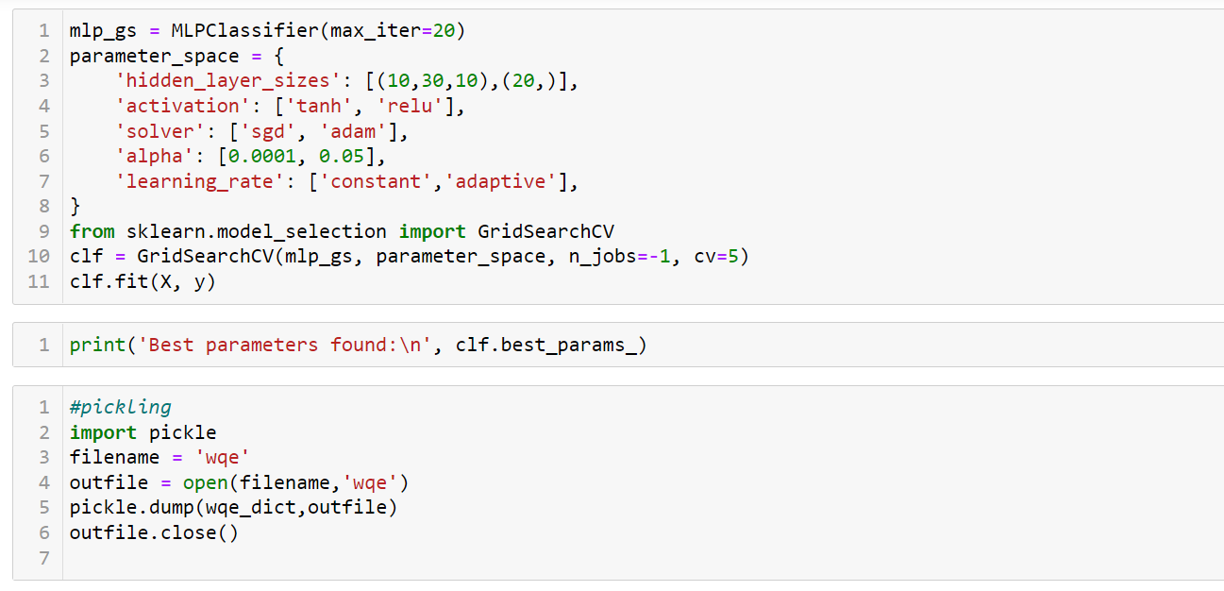
Hyperparameter tuning using GridSearchCV

Slide 21
CONCLUSION
The fake and true news was predicted using naive_bayes algorithrm and Mutilayer perceptron (MLP). It was seen that the naive_bayes yeilds Hamming Loss: 0.038604305864884926 and Accuracy Score: 0.961395694135115. The Mutilayer perceptron (MLP) gives Hamming Loss: 0.010244988864142539, Accuracy Score: 0.9897550111358575.
By visualization we can learn data distribution, words distribution before and after cleaning, Positive words and negative words etc. The fake and true news was predicted using naive_bayes algorithrm and Mutilayer perceptron (MLP). It was seen that the naive_bayes yeilds Hamming Loss: 0.038604305864884926 and Accuracy Score: 0.14. The Mutilayer perceptron (MLP) gives Hamming Loss: 0.010244988864142539, Accuracy Score: 0.42.

